Slide 1
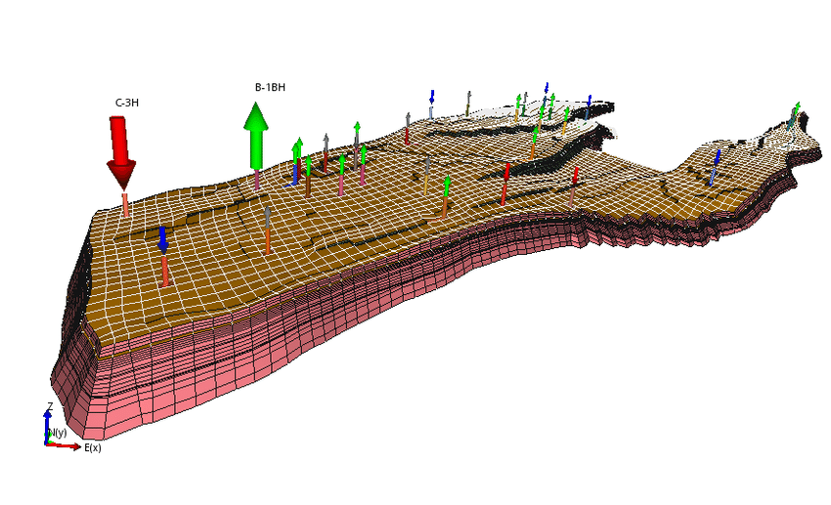
Machine Learning for Subsurface engineers
Dursun Dashdamirov, Nadir Zeynalli, Vugar Dunyamaliyev
Session II, 22 February 2026

Slide 2
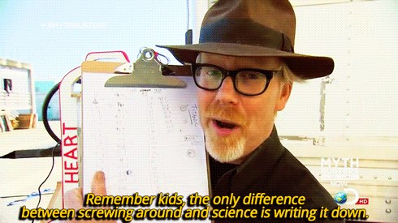
Logistics of lectures
2 hr lecture w/15 min break midway
Feel free to interrupt
Do not hesitate to ask questions
For best learning experience cover
extra references

Slide 3

About me
BSc in Petroleum Engineering from BHOS
MSc in Petroleum Engineering from ASOIU
4+ years in reservoir engineering and data science @eiLink
Specialized in subsurface modelling and uncertainty-aware predictions

Slide 4

1.1 Supervised machine learning
This is a type of machine learning paradigm where an algorithm learns to map input data to a specific output based on example input-output pairs.
$$Y=f\left(x_{1},x_{2},x_{3}\right) + ε$$
Target
Response
Independent
Irreducible error
Caused by
1.
2.
Bonus:
Deterministic structure relating 𝑥 to 𝑦
Predictor
Input
Dependent
=
f(
)
k (mD) | Net Pay (ft) | Sw
12 | 18 | 55
35 | 25 | 48
120 | 42 | 32
250 | 55 | 28
8 | 15 | 60
Productivity (y)
0
1
2
2
0
Notes:
1. Measurement noise 2. Unobserved / missing variables 3. Intrinsic randomness (human behavior, turbulent flow regimes etc.)

Slide 5
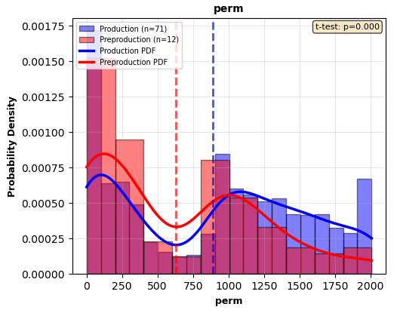
1.1 Assumptions of Supervised ML
The word “prediction” sounds magical. In reality, it rests on two fundamental statistical assumptions:
There is a probability distribution D over (x, y) pairs
The training and test data are random samples (x1, y1), . . . ,(xn, yn),(x, y) i.i.d. ∼ D
i.i.d = independent and identically distributed
Each (x,y) pair is randomly drawn from a population
=
f(
)
k (mD) | Net Pay (ft) | Sw
1200 | 2 | 89
1800 | 1 | 78
Productivity (y)
?
?
Notes:
correlated observations give less information. The model treats that cluster as 10 times more important than it actually is. 100 people from the same professional basketball team give you a "certain" result that is totally wrong.

Slide 6
2. Regression
Nadir Zeynalli
2.1 Linear regression
2.2 Cost function
2.3 Gradient descent
2.4 Multivariate linear regression
2.5 Polynomial regression
2.6 Regularization

Slide 7
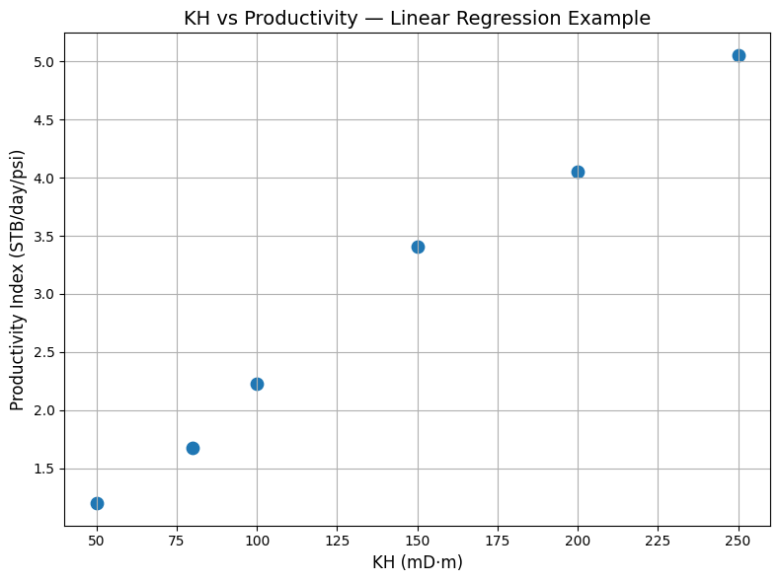

2.1 LINear regressIon
Models linear relationship between inputs and output
Fast to train and computationally efficient
Serves as foundation for many advanced ML models
f(
)=
kh (mD*m)
50
100
80
250
150
200
Productivity (y)
1.2
2.2
1.6
5
3.4
4
Analytical solution

Slide 8

2.1 LINear regressIon
Training set
What is the model of linear regression?
How to represent hypothesis?
Learning algorithm
X (input)
KH
Hypothesis
Y (Prediction/output)
Productivity
$$h_{θ}\left(x\right)=θ_{0}+θ_{1}x$$

Slide 9



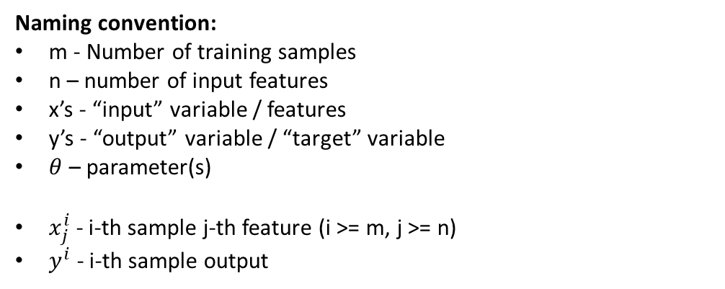










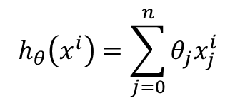


2.1 LINear regressIon
$$x_{1}$$
y
Naming convention:
m - Number of training samples
n – number of input features
x’s - “input” variable / features
y’s - “output” variable / “target” variable
$θ$ – parameter(s)
$x_{j}^{i}$ - i-th sample j-th feature (i >= m, j >= n)
$y^{i}$ - i-th sample output
kh (mD*ft) | Productivity (y)
50 | 1.2
100 | 2.2
80 | 1.6
250 | 5
150 | 3.4
200 | 4
$$x_{1}^{1}$$
$$y^{1}$$
$$x_{1}^{2}$$
$$y^{2}$$
$$x_{1}^{3}$$
$$y^{3}$$
$$x_{1}^{4}$$
$$y^{4}$$
$$x_{1}^{5}$$
$$y^{5}$$
$$x_{1}^{6}$$
$$y^{6}$$
$$h_{θ}\left(x\right)=θ_{0}+θ_{1}x_{1}$$
$$h_{θ}\left(x^{i}\right)=\sum_{j=0}^{n}{θ_{j}x_{j}^{i}}$$
$x_{0}=1$ always (dummy feature)

Slide 10
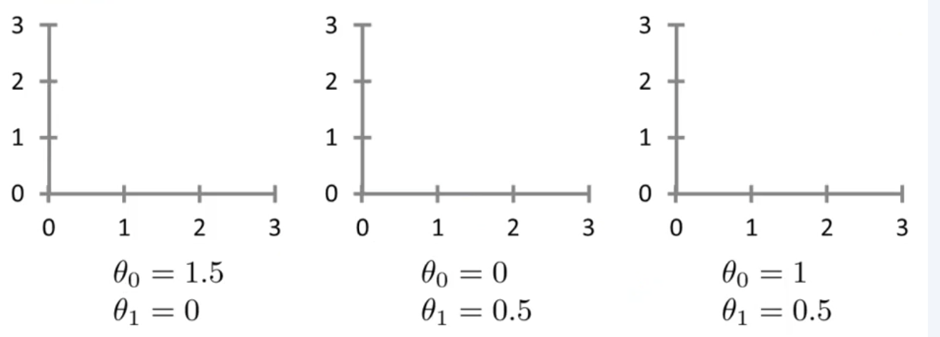
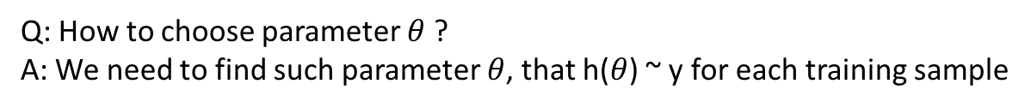

2.1 Linear regression
Q: How to choose parameter $θ$ ?
A: We need to find such parameter $θ$, that h($θ$) ~ y for each training sample
$$h_{θ}\left(x\right)=θ_{0}+θ_{1}x_{1}$$

Slide 11



2.2 Cost function
$$h_{θ}\left(x\right)=θ_{0}+θ_{1}x_{1}$$
Mean Squared Error
kh (mD*ft) | Productivity (y) | Prediction h(x) | Error
50 | 1.2 | 1
100 | 2.2 | 1.5
80 | 1.6 | 0.5
250 | 5 | 1
150 | 3.4 | 1.3
200 | 4 | 4
Other cost functions:
Squared – punish big errors strongly
Absolute – treat all errors proportionally
Huber – balanced
Cross-entropy – punish confident wrong predictions
Hinge – enforce margin
Quantile – predict distribution percentiles
Mean Absolute Error

Slide 12
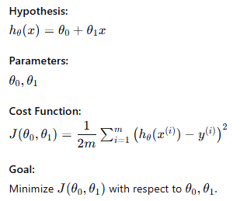
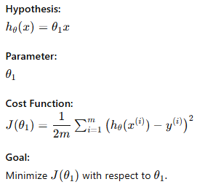
2.2 Cost function
Original
Simplified

Slide 13
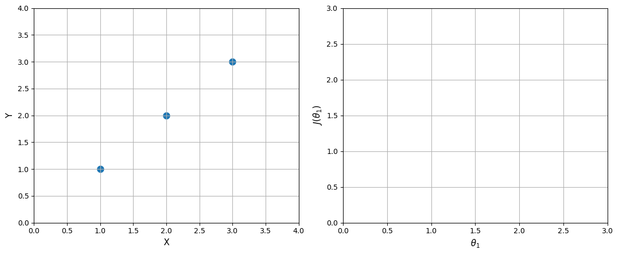



2.2 Cost function (simple)
$$h_{θ}\left(x\right)=θ_{1}x_{1}$$
$$h_{θ}(x)$$
$$J(θ_{1})$$

Slide 14
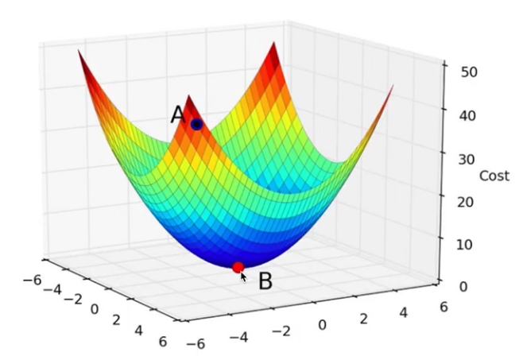
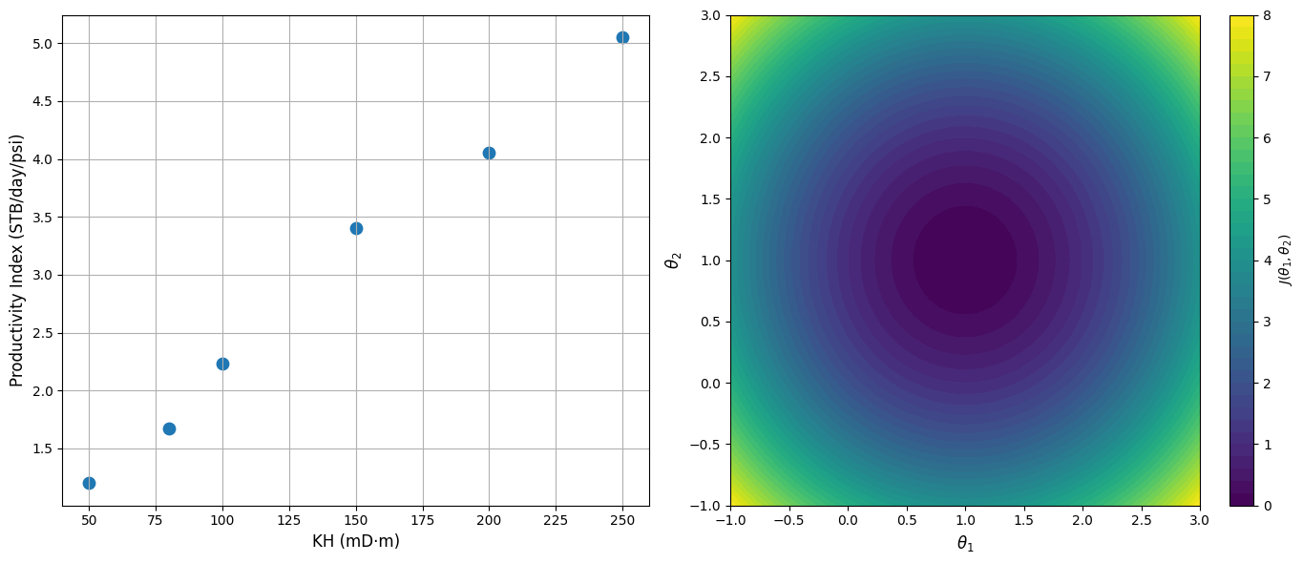
2.2 Cost function

Slide 15
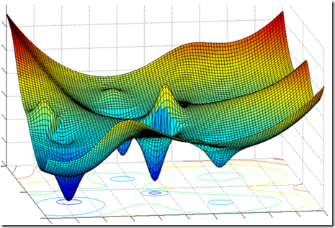
2.3 Gradient descent
Interesting fact:
Cost function in linear regression has always 1 local minima, which is also global minima
Why: cost function is quadratic
Steps:
Start from random point
Measure error
Check slope
Adjust
Repeat

Slide 16
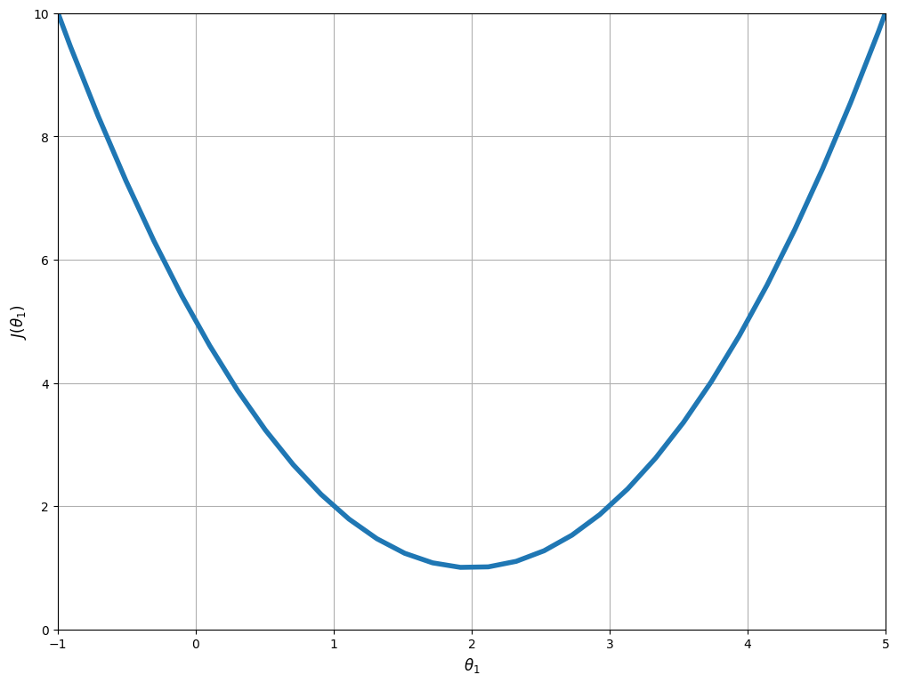





2.3 Gradient descent
Simplified case - $J(θ_{1})$
$α$ – learning rate (aka step size)

Slide 17
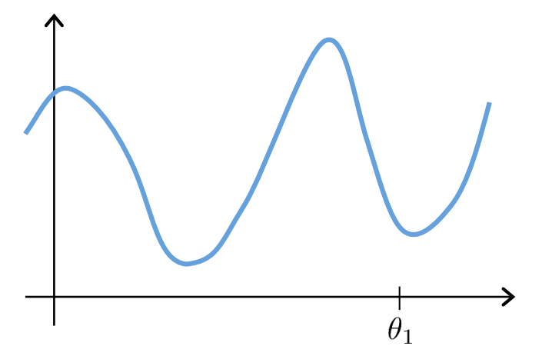
2.3 Gradient descent
Question:
What will happen during the parameter update if initial parameter starts at local minima?

Slide 18







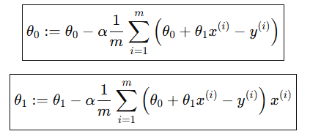

2.3 Gradient descent
Remember:
$$h_{θ}\left(x\right)=θ_{0}+θ_{1}x_{1}$$

Slide 19







2.4 Multivariate linear regression
$$x_{1}$$
$$x_{2}$$
$$x_{3}$$
$$x_{4}$$
$$y$$
k (mD) | Net pay (ft) | Vshale | Sw | Productivity (y)
50 | 12 | 0.23 | 0.1 | 1.2
100 | 8 | 0.05 | 0 | 2.2
80 | 11 | 0.51 | 0.5 | 1.6
250 | 5 | 0.33 | 0.8 | 5
150 | 2 | 0.14 | 0.1 | 3.4
200 | 15 | 0.62 | 0.3 | 4
Gradient descent:

Slide 20
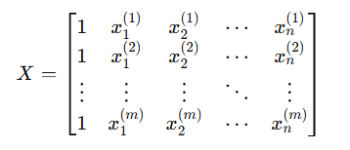

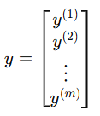
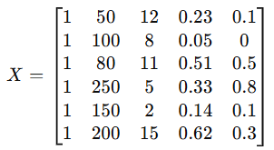
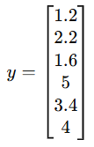





Normal equation
k (mD) | Net pay (ft) | Vshale | Sw | Productivity (y)
50 | 12 | 0.23 | 0.1 | 1.2
100 | 8 | 0.05 | 0 | 2.2
80 | 11 | 0.51 | 0.5 | 1.6
250 | 5 | 0.33 | 0.8 | 5
150 | 2 | 0.14 | 0.1 | 3.4
200 | 15 | 0.62 | 0.3 | 4
Design matrix
Finding minimum

Slide 21
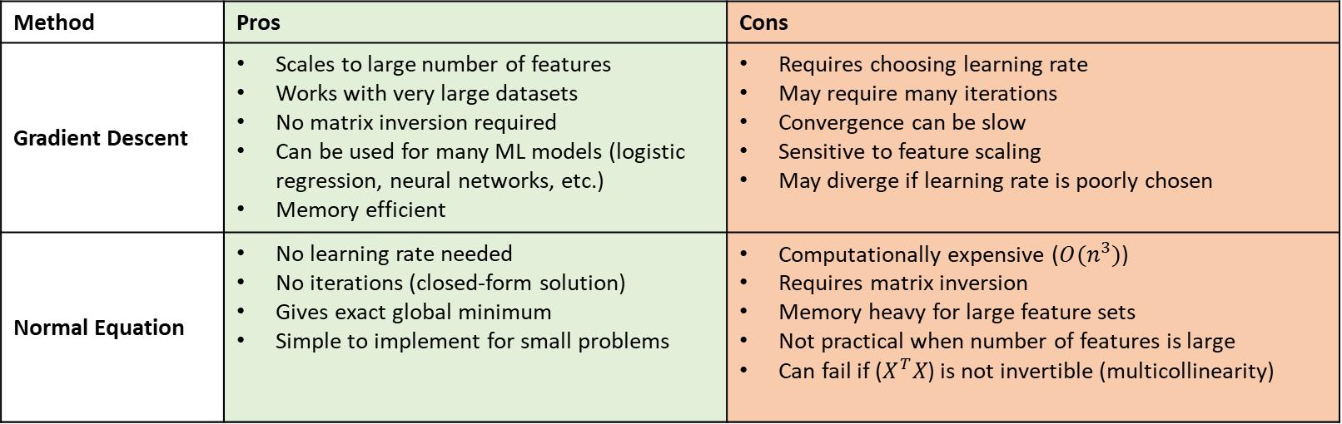
Gradient descent vs normal equation
Method | Pros | Cons
Gradient Descent | Scales to large number of features Works with very large datasets No matrix inversion required Can be used for many ML models (logistic regression, neural networks, etc.) Memory efficient | Requires choosing learning rate May require many iterations Convergence can be slow Sensitive to feature scaling May diverge if learning rate is poorly chosen
Normal Equation | No learning rate needed No iterations (closed-form solution) Gives exact global minimum Simple to implement for small problems | Computationally expensive ($O(n^{3})$) Requires matrix inversion Memory heavy for large feature sets Not practical when number of features is large Can fail if ($X^{T}X$) is not invertible (multicollinearity)

Slide 22



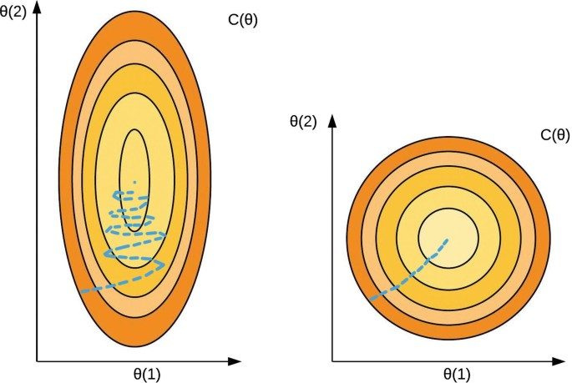

Feature scaling
Mean Normalization
Standardization (Z-score Scaling)
Sw | kh (mD*ft) | Productivity (y)
0.1 | 5000 | 1.2
0 | 10000 | 2.2
0.5 | 800 | 1.6
0.8 | 2500 | 5
0.1 | 1500 | 3.4
0.3 | 2000 | 4
Min–Max Scaling
Method | Mean | Variance | Range | Outlier Sensitivity | Most Common Use
Mean Normalization | 0 | Not fixed | ≈ −1 to 1 | Medium | Basic GD
Standardization | 0 | 1 | Unbounded | High | Most ML models
Min–Max | Not centered | Not fixed | [0,1] | Very High | Neural Networks
$$h_{θ}\left(x\right)=θ_{0}+θ_{1}x_{1}+θ_{2}x_{2}$$
Problems:
Cost function becomes stretched (elliptical contours)
Updates zig-zag
Convergence becomes slow
May require very small learning rate

Slide 23
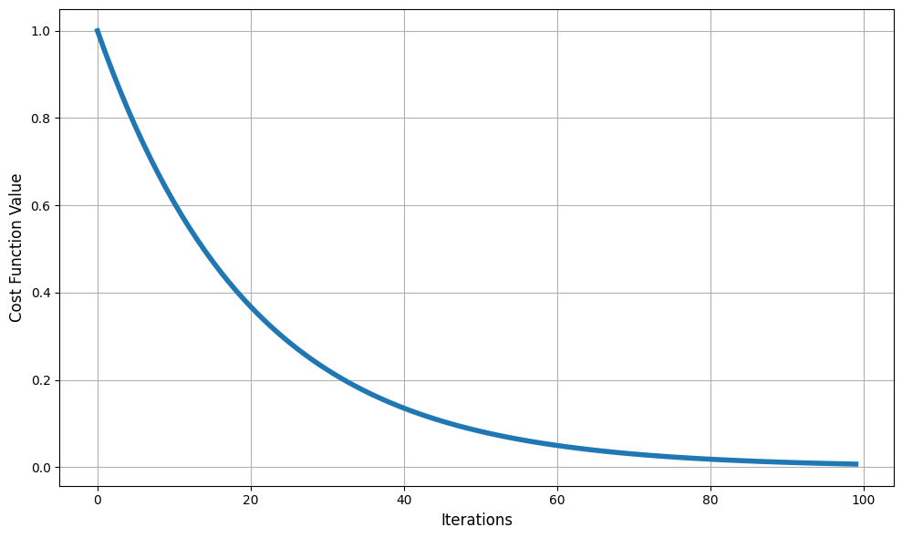
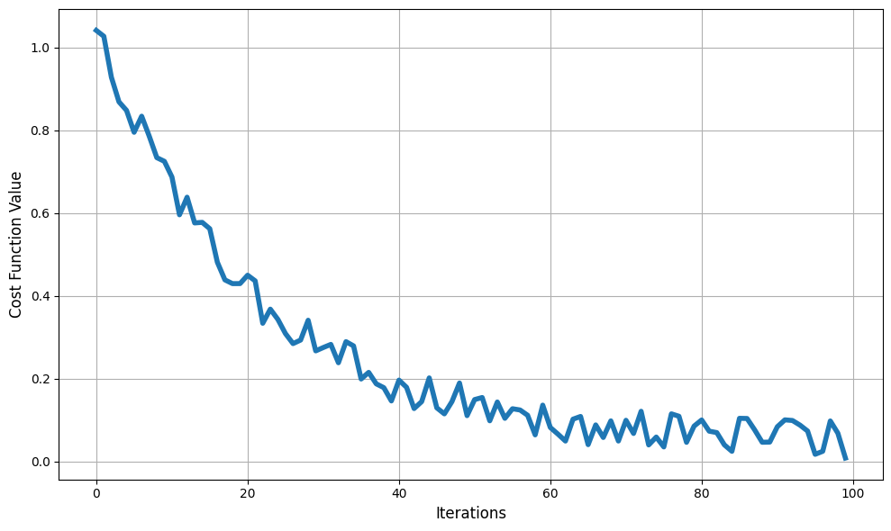
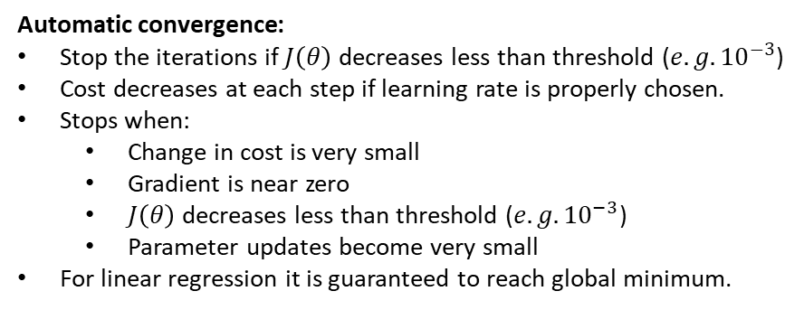
Learning rate & convergence
Automatic convergence:
Stop the iterations if $J\left(θ\right)$ decreases less than threshold (${e.g. 10}^{−3}$)
Cost decreases at each step if learning rate is properly chosen.
Stops when:
Change in cost is very small
Gradient is near zero
$J\left(θ\right)$ decreases less than threshold (${e.g. 10}^{−3}$)
Parameter updates become very small
For linear regression it is guaranteed to reach global minimum.
Learning rate selection:
Mostly try and error
Controls step size during updates.
Small α – slow convergence.
Large α – may overshoot or diverge.
Too large – cost oscillates or explodes.
Typical strategy:
Start small (e.g., 0.01)
Monitor cost
Adjust if diverging or too slow

Slide 24
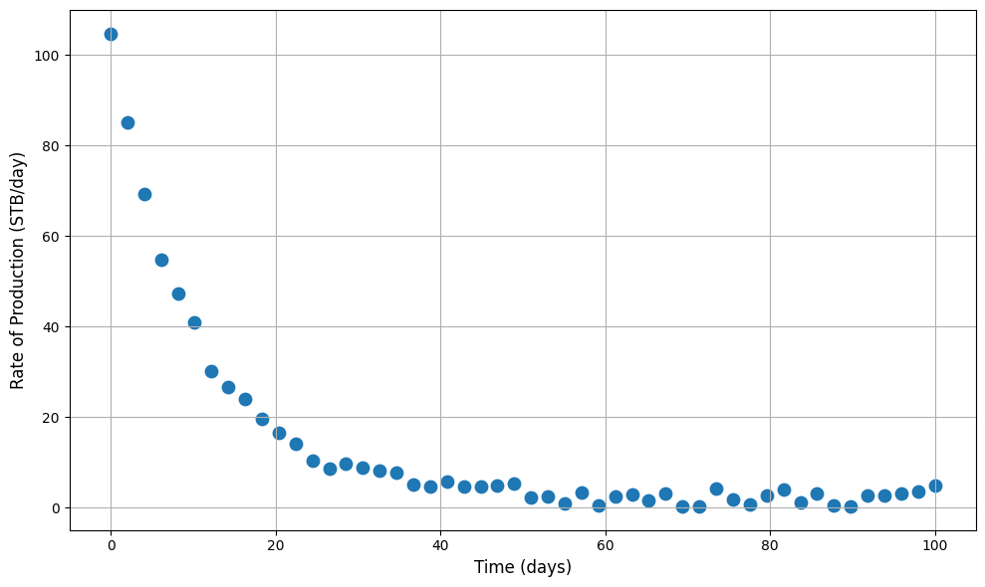
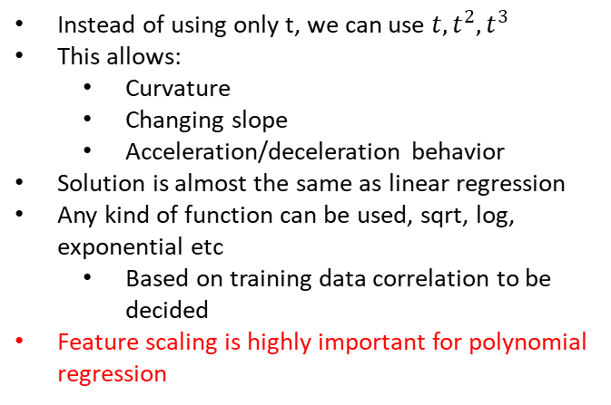


2.5 Polynomial regression
t
q(t)
Time (days) | Rate (STB/day)
0.000000 | 104.680774
2.040816 | 85.019730
4.081633 | 69.337338
6.122449 | 54.699129
8.163265 | 47.280290
Typical well behavior:
High initial production
Rapid decline
Slower late-time decline
A straight line cannot capture this.
Instead of using only t, we can use $t, t^{2},t^{3}$
This allows:
Curvature
Changing slope
Acceleration/deceleration behavior
Solution is almost the same as linear regression
Any kind of function can be used, sqrt, log, exponential etc
Based on training data correlation to be decided
Feature scaling is highly important for polynomial regression
$q\left(t\right)=θ_{0}+θ_{1}t+θ_{2}t^{2}$ + $θ_{3}t^{3}$
$q\left(t\right)=110+32t+12t^{2}−$ 0.5$t^{3}$

Slide 25
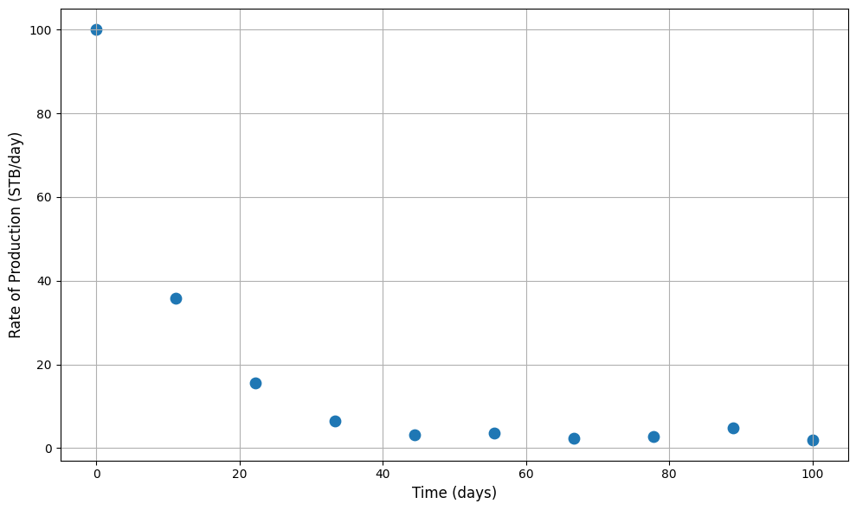


Overfitting
Underfit / high bias
Proper fit
Overfit / high variance
$$h_{θ}\left(x\right)=θ_{0}+θ_{1}x_{1}$$
$$h_{θ}\left(x\right)=θ_{0}+θ_{1}x_{1}+θ_{2}x_{2}^{2}$$
$$h_{θ}\left(x\right)=θ_{0}+θ_{1}x_{1}+θ_{2}x_{2}^{2}+θ_{3}x_{3}^{3}+θ_{4}x_{4}^{4}$$
Overfitting - when a model learns the training data too well—including noise and random fluctuations, so it performs poorly on new, unseen data.
Underfitting - when a model is too simple to capture the underlying pattern in the data, resulting in poor performance on both training and unseen data.
Bias - systematic error caused by wrong assumptions in the model
High bias = model is too rigid
Variance - model changes too much depending on the training data.
High variance = model too flexible
Consider when overfitting:
Reduce the number of features
Change the model
Use regularization
Consider when underfitting:
Increase model complexity (feature engineering)
Add more features
More training iterations might help

Slide 26


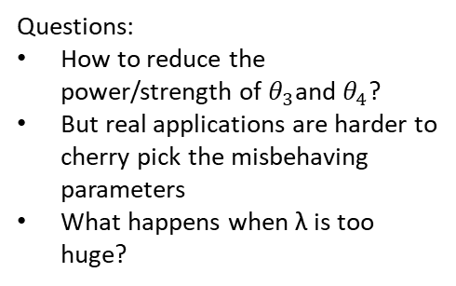

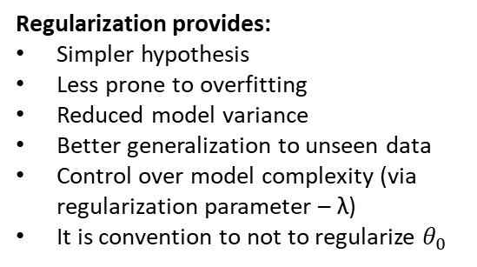
2.6 regularization
Proper fit
Overfit / high variance
Questions:
How to reduce the power/strength of $θ_{3}$and $θ_{4}$?
But real applications are harder to cherry pick the misbehaving parameters
What happens when λ is too huge?
$$h_{θ}\left(x\right)=θ_{0}+θ_{1}x_{1}+θ_{2}x_{2}^{2}$$
$$h_{θ}\left(x\right)=θ_{0}+θ_{1}x_{1}+θ_{2}x_{2}^{2}+θ_{3}x_{3}^{3}+θ_{4}x_{4}^{4}$$
Regularization provides:
Simpler hypothesis
Less prone to overfitting
Reduced model variance
Better generalization to unseen data
Control over model complexity (via regularization parameter – λ)
It is convention to not to regularize $θ_{0}$

Slide 27
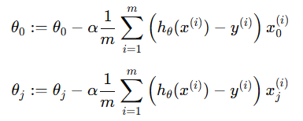



2.6 regularization
Gradient descent without regularization:
Gradient descent with regularization:
Shrinking $θ_{j}$ each time

Slide 28
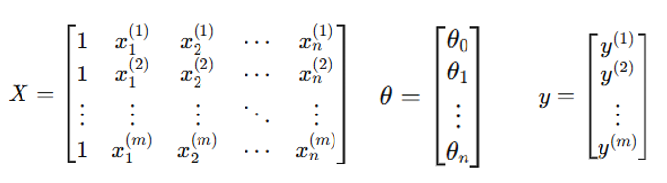
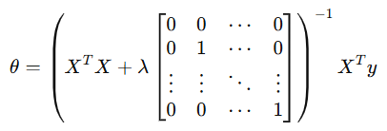

2.6 regularization
Normal equation solution without regularization:
Normal equation solution with regularization:
If n=2, then:

Slide 29
Back up slides

